Slide 1
How To Resolve: Lync Keychain Errors

Slide 2
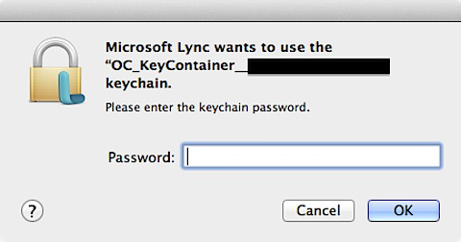
Keychain Error While Using Microsoft Lync
At launch, and intermittently during usage, the following error is regularly displayed.
The redacted section in the example to the right likely contains your email address or TE user ID.
Entering your password and clicking OK does not resolve the issue, often prompting the same error to immediately be redisplayed.

Slide 3
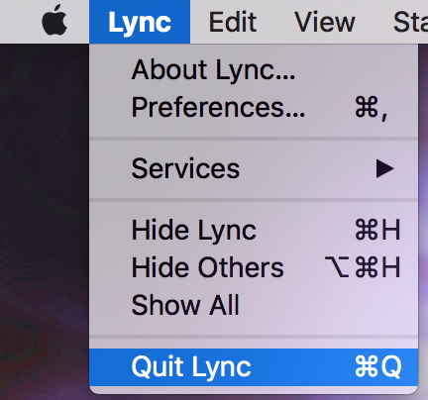
Quit Lync
The following operations cannot proceed with the application open, you will need to Quit Microsoft Lync to continue.
From the Lync menu in the upper left, select the Quit Lync option
This is also hot keyed to Command-Q

Slide 4
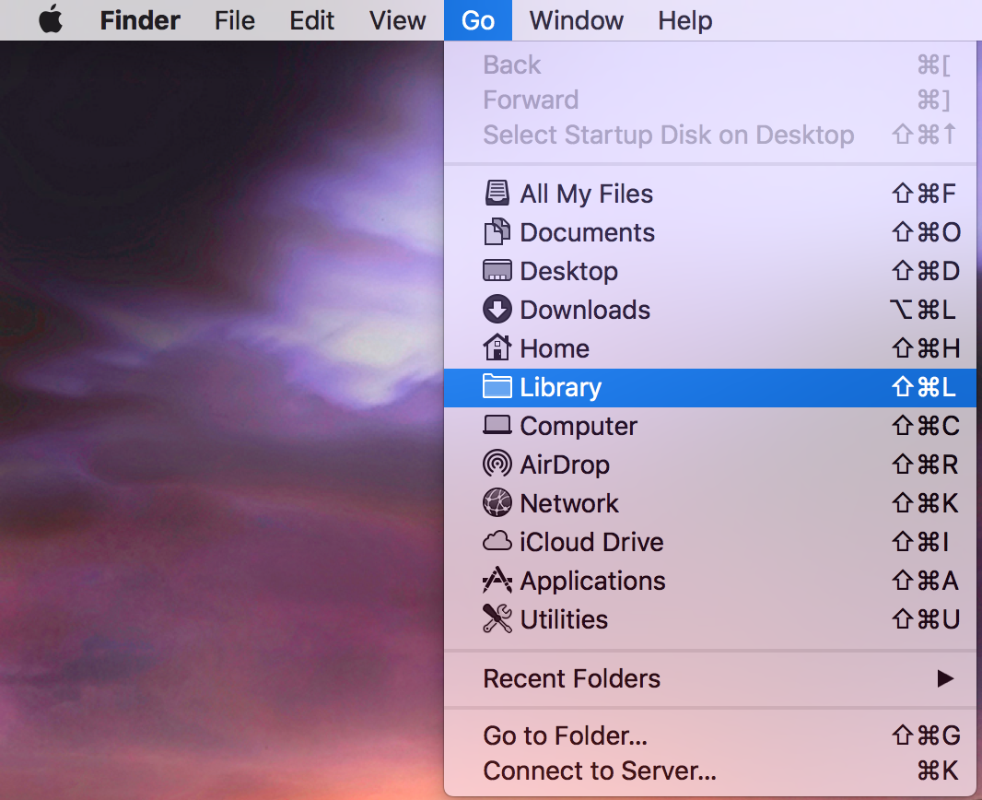
Open Your Library Folder
Click in Finder or on your Desktop to make Finder the front-most application.
With the Shift key held down, select the “Go” menu from Menubar in the upper left.
Select the “Library” option from this list. The Library choice will only be visible when the Shift key is pressed.
This will take you to the Library folder in your Home folder (aka “~/Library”). There are other Library folders on your computer, we specifically need the one in your home folder, which this menu item will take us to.

Slide 5
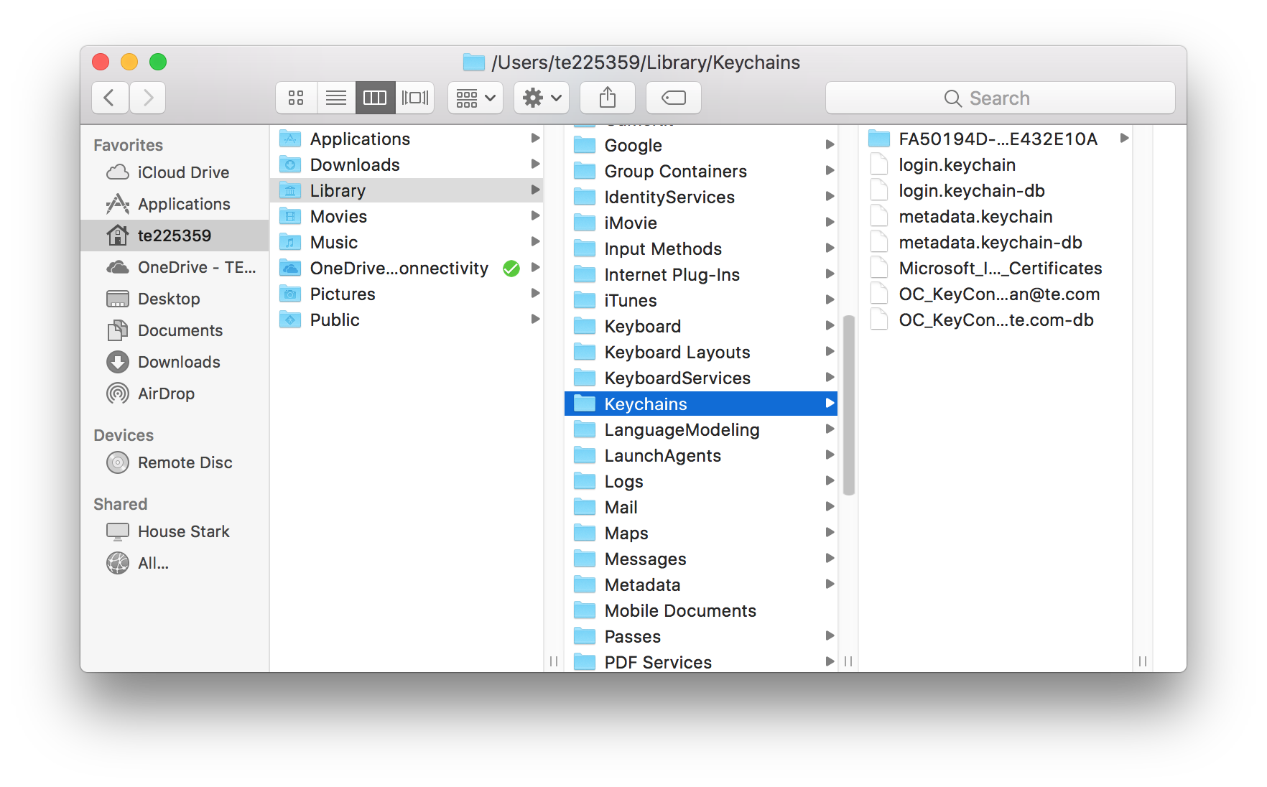
Open the Keychains subfolder
From inside your Library folder, find the subfolder named “Keychains” and open it.

Slide 6
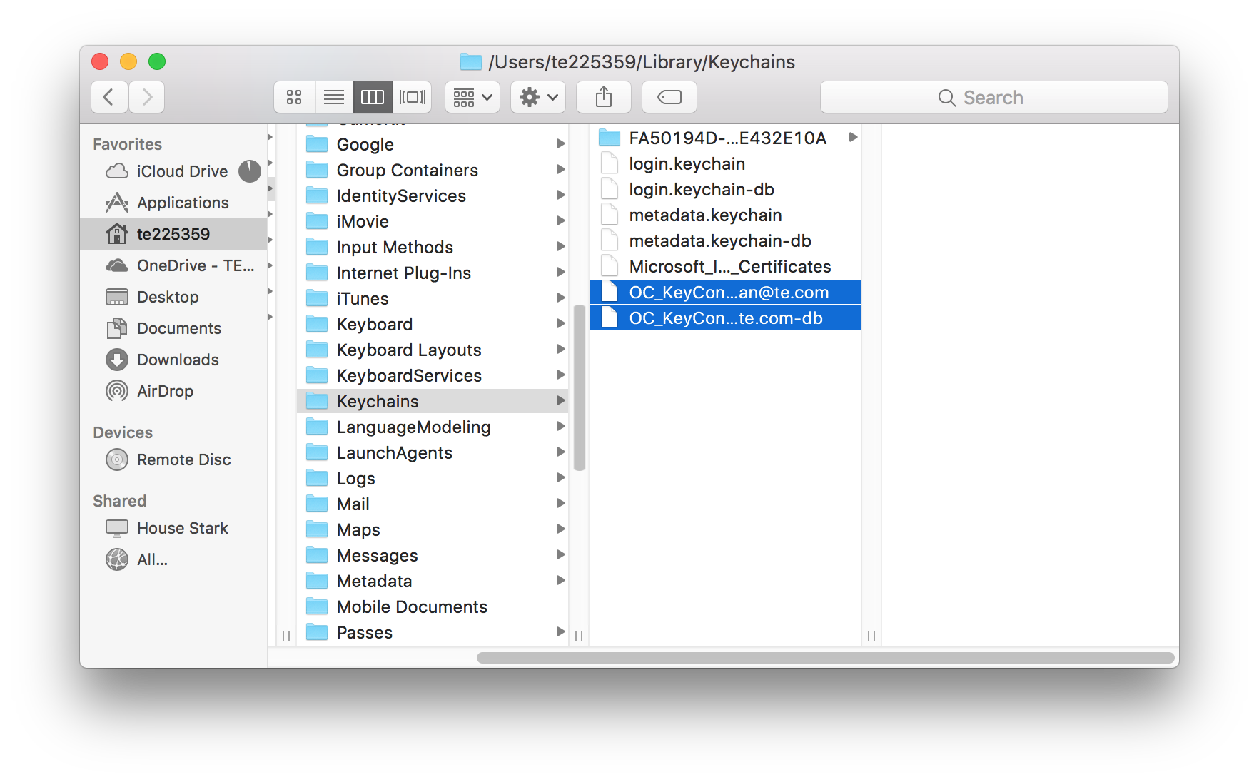
Select the Lync Keychain files
From the contents of your Keychains folder, select any files that contain the name “OC_KeyContainer”
Most users will have 2 such files, though you may have more if you have used different user names to log into Lync in the past.
You can select multiple items by holding down the Command key while clicking on each item.

Slide 7
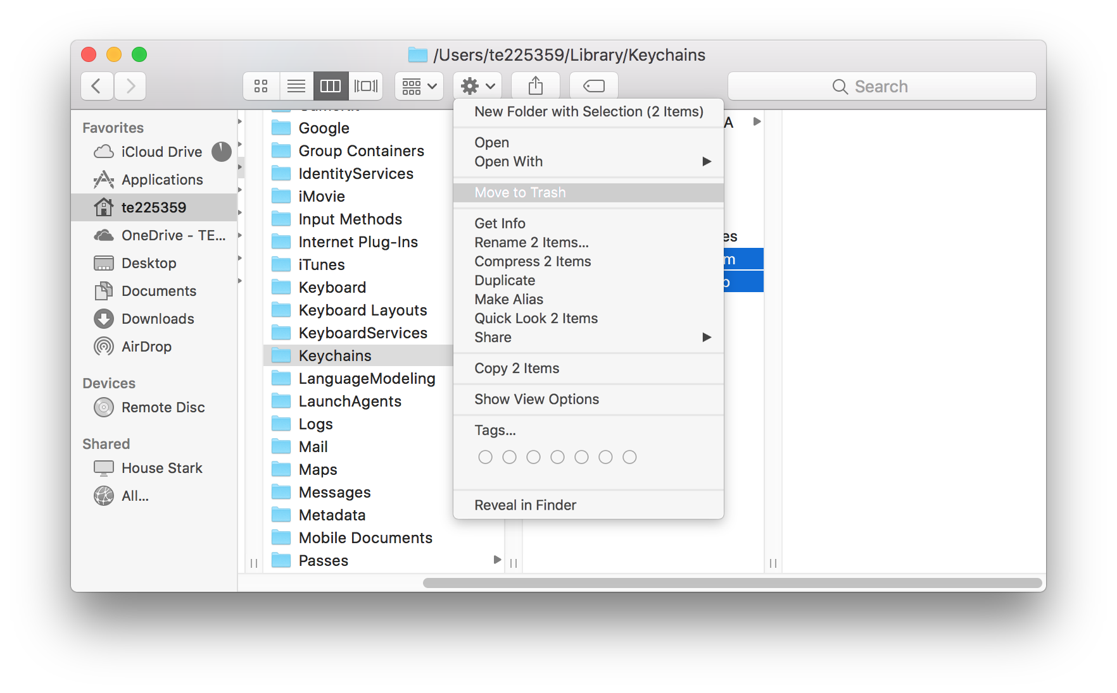
Delete the files.
The selected files need to be deleted. This can be accomplished in several possible ways.
You could drag all of the selected items to the trash icon in your dock.
With the items selected, the hot key “Command-Delete”
on some keyboards, the “Delete” key may be labeled “Backspace”, it is the key to the right of the “+”
You could secondary click on the selected files, and select “Move to Trash” from the contextual menu.
You can click on the Action “gear” button and select “Move to Trash” from the menu.

Slide 8
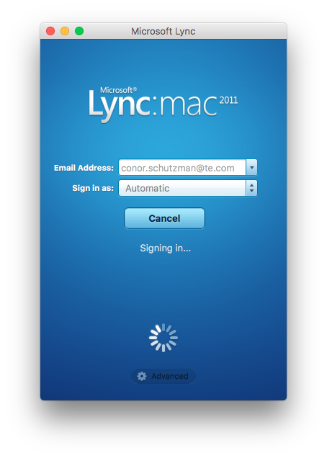
Restart Lync
Once these files have been moved to the trash, you can relaunch Lync.
This initial relaunch of Lync may take longer than normal, as Lync will recreate the deleted files.
You should not be able to use Lync normally without encountering the previous errors.

